Slide 1
Development of a Flexible High Yielding, High Performing Process for Manufacturing of AFTX-201, a Novel Investigational AAV Gene Therapy for Treatment of BAG3 Dilated Cardiomyopathy
2025 ASGCT
Matt Edwards, VP Process Science

Slide 2
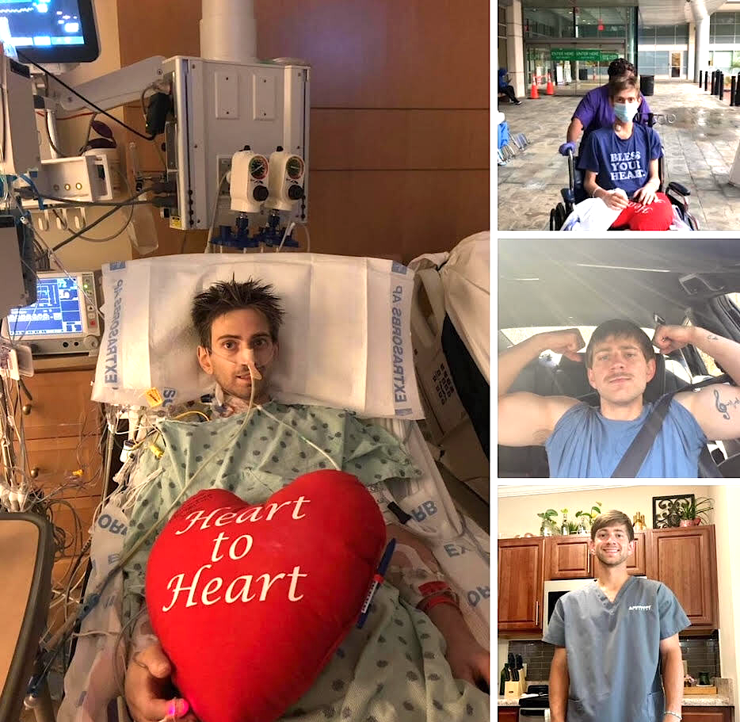
BAG3 DCM is a devastating disease
A significant market for gene therapy
76K patients in developed markets
Increasing genotyping and diagnosis
Forecasted peak annual WW sales >$2B²
No. of patients with BAG3 DCM in developed markets
Disease biology and unmet medical need
Monogenic disease with haploinsufficiency
Diagnosed at a mean age of 37 years
64% are in NYHA Class II – IV at presentation
Current treatments for symptomatic improvement
22% with DCM require a heart transplant
DeGroot, S. (2024, August 16). Facebook; accessed October 2, 2024.
Sentero Pharma market research & forecast
2

Slide 3

AFTX-201 reversed disease pathology in the BAG3 cKO mouse model: increased EF and improved dilated cardiomyopathy
BAG3 cKO mouse model closely mimics the structural, functional, and molecular defects observed in patients affected by BAG3 DCM
Ejection fraction
Fractional shortening
Restore BAG3 protein to normal level with a full-length, fully-human BAG3 transgene using Affinia’s novel cardiotropic capsid
Reverse disease pathology: increase contractility, reduce dilation, increase ejection fraction and exercise capacity
Affinia solution: AFTX-201
Dilated heart
BAG3 protein
Cardiac contractility
Patient exercise capacity

Slide 4
Affinia’s novel cardiotropic capsids are engineered to address the limitations of conventional capsids in heart disease
In clinical trials, conventional capsids have been unable to transduce >30% cardiomyocyte at tolerated doses¹
Affinia’s novel cardiotropic capsids have demonstrated superiority vs. conventional capsids in NHP and in human cardiomyocytes
Target capsid profile
Head-to-head capsid performance in human cardiomyocytes
Head-to-head capsid performance in NHP heart at 3e13 vg/kg IV
>30% | AAV dose ≥ 1e14 vg/kg IV
<30% |  | AAV dose ≤ 6e13 vg/kg IV
 | Dose not tolerated | Dose tolerated
% cardiomyocytes transduced
1) Internal analysis based on public information from AAV9-based clinical programs
Left: PR-0025 cynos (n=3-4), CAG.GFP 3e13 vg/kg IV, day 28; heart LV % cardiomyocytes GFP+
Right: iPSC derived cardiomyocytes, 96-well assay, 50K cells per well, 72h incubation, in duplicate
4

Slide 5
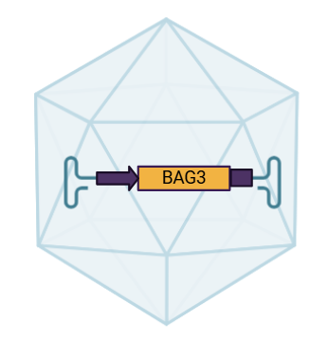

Process development for AFTX-201
Goal was to develop a robust process for a novel capsid to support a Phase 1/2 clinical trial for BAG3 DCM
High-Yielding
  Conduct manufacturability assessment during capsid selection to ensure good productivity of novel capsid
  Enable lower manufacturing costs
High performing
  Achieve low residuals and high % full capsids
Stability
  Conduct manufacturability assessment to ensure stability of novel capsids
Flexibility
  Demonstrate strong performance across multiple payloads and capsids
AFTX-201
ATC-0187
AAV9 with peptide insertion

Slide 6
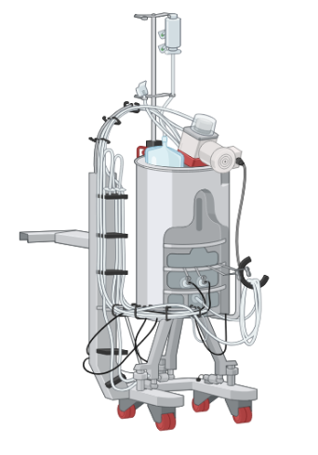
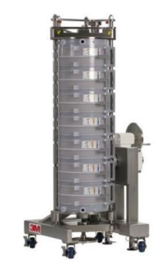
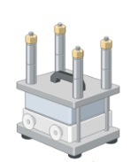
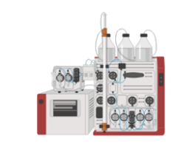
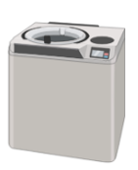


Process flow diagram for AFTX-201
Utilize Affinia's novel plasmid design to increase yields
Explore multiple Affinity resins to ensure high performance
Explore new depth filters to increase capacity
Using CsCl gradient to ensure >90% full capsids

Slide 7
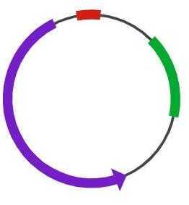
Use of Affinia plasmid design led to yields of >3e15 vg/L
Affinia
plasmid design
% full capsids
Condition
Condition
We chose condition with highest yield to move forward since we were utilizing CsCl gradient for polishing
Notes:
Change graph to vg/L

Slide 8
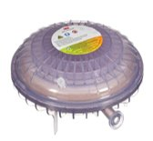
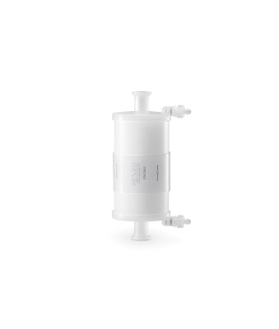
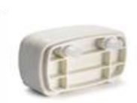
Harvest RC filters were optimal process choice
Harvest RC plus STIC
HCP Breakthrough
hcDNA Breakthrough
+
Millipore plus STIC
+
+
Note: Millipore filter was stopped due to rising pressure
Harvest RC filter better choice than Millipore DF
  Higher loading capacity
  Cheaper at scale
  Reduced HCP and hcDNA levels
Notes:
Need to swap out graphs once I have access to raw data from Matt B.

Slide 9
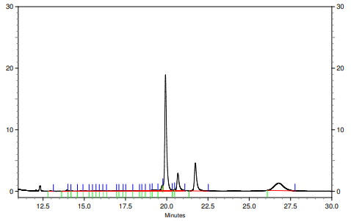
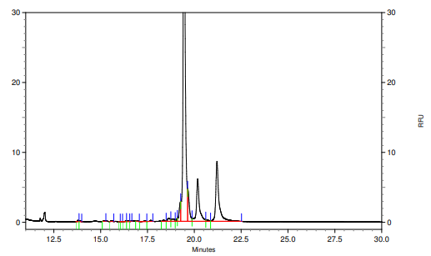
AviPure Affinity resin were the optimal process choice
Purified with Poros AAV9
Purified with AviPure AAV9
G3BP
contaminant
Avipure resin better choice than Poros AAV9
  Similar binding capacity
  Similar yield (>85%)
  Reduced G3BP contaminant
  Easily cleaned and reusable

Slide 10

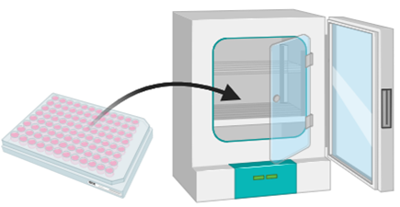
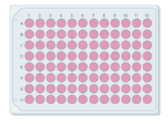
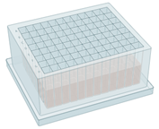

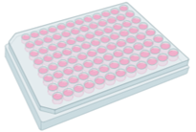
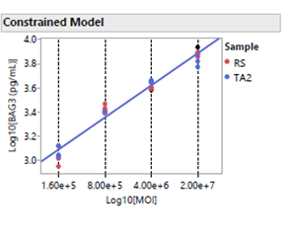
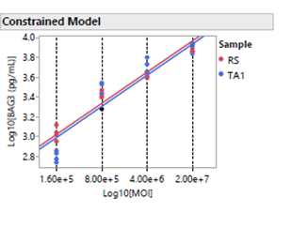
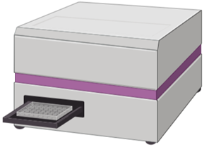
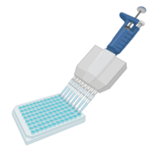

Potency assay for AFTX-201 developed to help support process development
RS
TA
Cell plating
Viral serial dilution
Infection
Incubation at 37 ◦C
Protein extraction
AFTX Lot 2
Forge Lot 2
Protein expression- ELISA

Slide 11
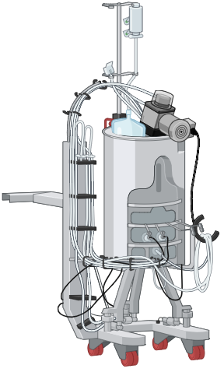
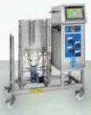

Process for AFTX-201 was successfully tech transferred to Forge Biologics
 | AFTX Lot 1 | AFTX Lot 2 | Forge Lot 1 | Forge Lot 2
hcDNA | 5.17e4 pg / 1e13 | Pending | 9.13e3 pg / 1e13 | 2.9e4 pg / 1e13
HCP | BLOQ | BLOQ | BLOQ | BLOQ
% Full / Partial / Empty by AUC | 95 / 4 / 1 | 94 / 4 / 2 | 95 / 3 / 1 | 96 / 2 / 2
Aggregation | 99.3 | 97.6 | 90.73 | 96.56
rcAAV | BLOQ | BLOQ | BLOQ | BLOQ
Relative potency | ND | Passed | ND | Passed

Slide 12

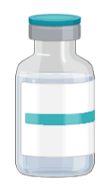

Conclusions
Developed a robust process for a novel capsid that achieves high yield and quality in support of Phase 1/2 clinical trials
Attain yields of >4e15 vg/L at scale with the AFTX-201 process
Ensure excellent critical quality attributes (CQAs)
Reduce manufacturing costs
50L Bioreactor
~2e17 total vg
Drug Product
~5e16 total vg
~60 doses
8e14 total vg
(80kg @1e13vg/kg)
~30K/dose

Slide 13

Acknowledgments
Process Science Team
  Esther Aribilola
  Matt Bennett
  Patrick Bresnahan
  Rong Cong
  Paul Freeman
  Ramin Kamran Sami
  Mike White
Rob May
Analytical Science Team
  Hannah Czeladko
  Spencer Fielder
  Graham Lilley
  Shahrzad Parker
  Lauren Sargent
  Jordan Shufro
Upstream Team
  Danielle Sexton
  Aimee Doiron
  Caitlin Austin
Downstream Team
  Corben Davis
  Nicole Hoefer
  Mreedul Koirala
  Benjamini Stillions
Potency Assay Team
  Devon Blake
  Julie Selich-Anderson

